Slide 1

Snake Game Using Python BACHELOR OF TECHNOLOGY In Computer Science and Engineering by SAIF AHMED KHAN(1/18/FET/BCS/066) ANSHUL BHARDWAJ(1/18/FET/BCS/080) SHREY JAIN(1/18/FET/BCS/092) Under the supervision of DR.SUMAN BHATIA Associate Professor Faculty of Engineering & Technology Manav Rachna International Institute of Research and Studies FACULTY OF ENGINEERING & TECHNOLOGY, MANAV RACHNA INTERNATIONAL INSTITUTE OF RESEARCH & STUDIES SECTOR-43, SURAJKUND –DELHI ROAD, FARIDABAD – 121001

Slide 2
CONTENT
INTRODUCTION TO PYTHON
GAME DEVELOPMENT USING PYTHON
PROBLEM DEFINITION
ABSTRACT AND OJECTIVES
HARDWARE AND SOFTWARE REQUIREMENTS
SNAKE GAME USING PYTHON
PYTHON MODULE USED
METHODOLOGY
PROJECT SCOPE
REFERENCES

Slide 3
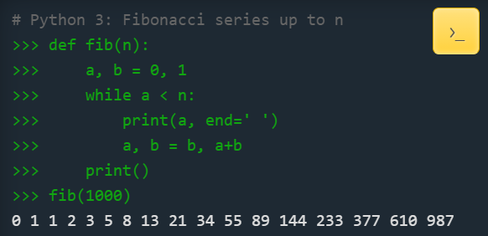
INTRODUCTION TO PYTHON
Python is an interpreted, high-level and general-purpose programming language. Python's design philosophy emphasizes code readability with its notable use of significant whitespace. Its language constructs and object-oriented approach aim to help programmers write clear, logical code for small and large-scale projects.
Python is dynamically typed and garbage-collected. It supports multiple programming paradigms, including structured (particularly, procedural), object-oriented language.
Python

Slide 4
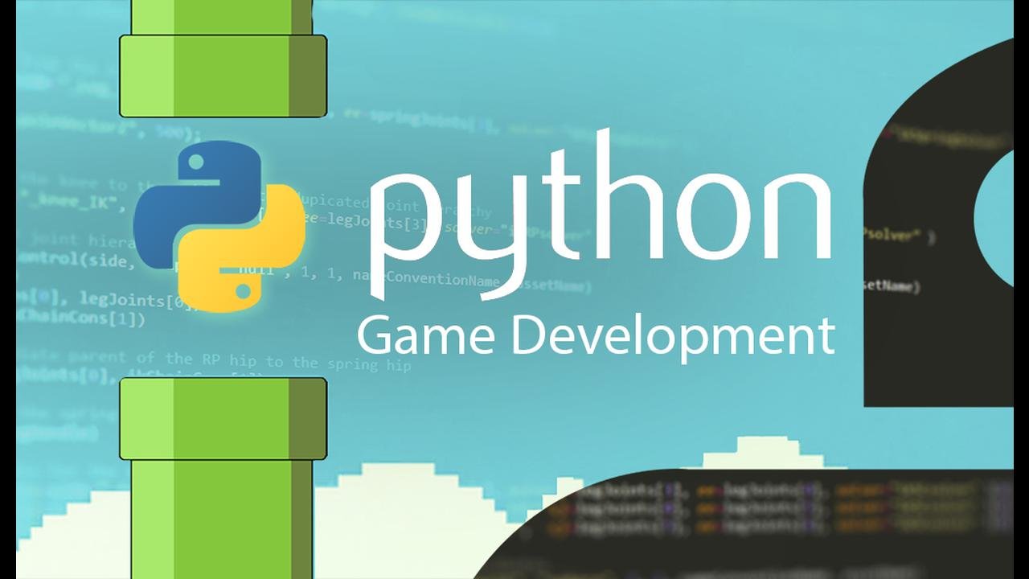
GAME DEVELOPMENT USING PYTHON
Game development with Pygame is a tutorial that is an introduction to Pygame. Also contains tutorials on how to make several basic games in Pygame. If you're interested in learning how to use Pygame to create 3D games, two sites that are dedicated to 3D Python are Python 3D(py3d.org) and Python 3D Software.

Slide 5
PROBLEM STATEMENT
We have created a Python-based-game using the following modules:
Turtle: It is a pre-installed python library that enables users to create shapes and pictures by providing them a virtual canvas.
Time: This function is used to count the number of seconds elapsed since the epoch.
Random: This function is used to generate random numbers in Python by using random module
Pygame: This function is used to generate graphics.

Slide 6
ABSTRACT
A snake game is an arcade maze game which has been developed by Gremlin Industries and published by Sega in October 1976. It is considered to be a skilful game and has popularized among people for generations. The objective of this python project is to build a snake game. In this python project, the player has to move a snake so it touches the fruit. If the snake touches itself or the border of the game then the game will over.

Slide 7
OBJECTIVES
The snake in the Snake game is controlled using the four direction buttons relative to the direction it is headed in.
The player’s objective in the game is to achieve maximum points as possible by collecting food or fruits.
The player loses once the snake hits the wall or hits itself.

Slide 8
HARDWARE AND SOFTWARE REQUIREMENTS
SOFTWARE REQUIREMENTS:
OPERATING SYSTEM :-WINDOWS
APPLICATION SOFTWRE :-JUPYTER NOTEBOOK (PYTHON) & VSCODE
TOOLKIT :-TURTLE & PYGAME
HARDWARE REQUIREMENT:
HARDISK :- 32 GB & ABOVE
RAM :- 128 MB & ABOVE
PROCESSOR :- ANY PENTIUM VERSION & ABOVE

Slide 9
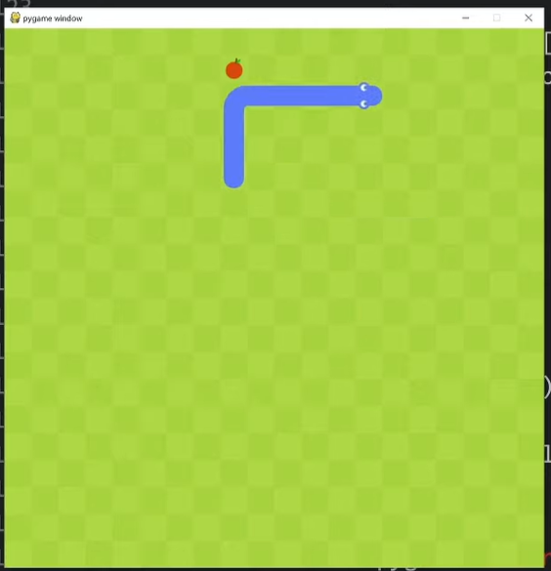
SNAKE GAME USING PYTHON
A snake game is an arcade maze game which has been developed by Gremlin Industries and published by Sega in October 1976. It is considered to be a skillful game and has popularized among people for generations.
This includes applying draw, time, and display modules, handling different types of events, and defining functions for completing the game logic.

Slide 10
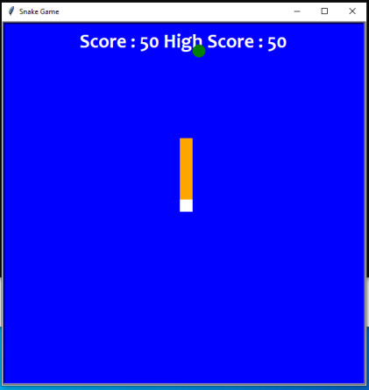
PYTHON MODULE USED
Turtle: It is a pre-installed python library that enables users to create shapes and pictures by providing them a virtual canvas.
Time: This function is used to count the number of seconds elapsed since the epoch.
Random: This function is used to generate random numbers in Python by using random module.
Pygame: This is a cross-platform set of Python modules which is used to create video games.

Slide 11
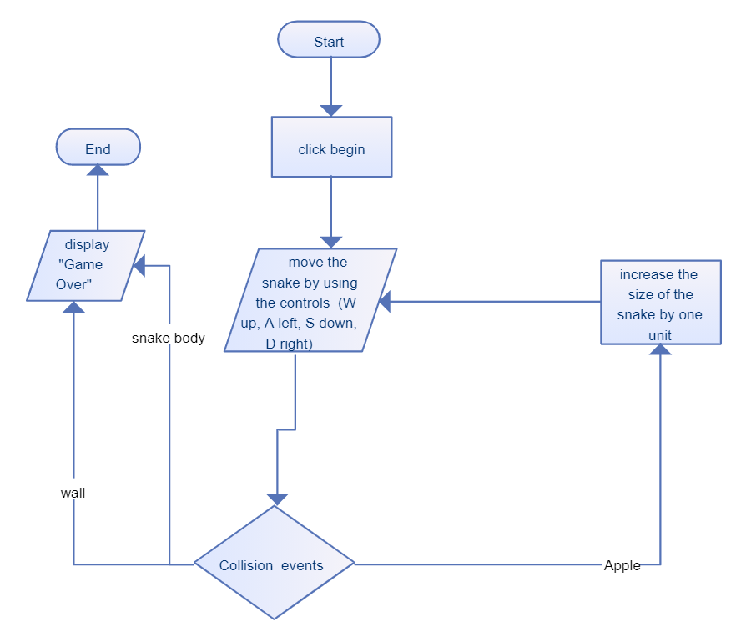
FLOW CHART

Slide 12
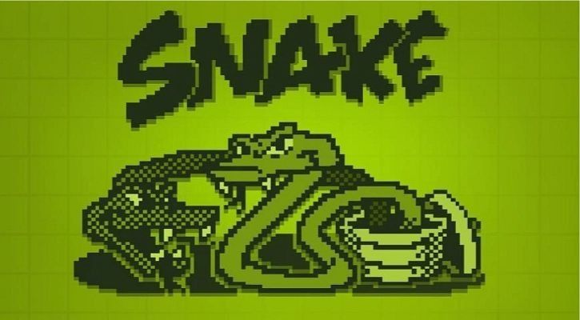
Step-by-step Approach To Create A Snake Game Using Turtle Module

Slide 13
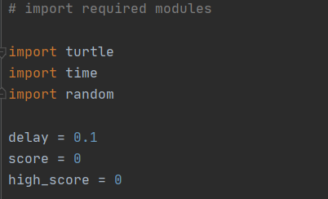
Step 1: importing modules

Slide 14
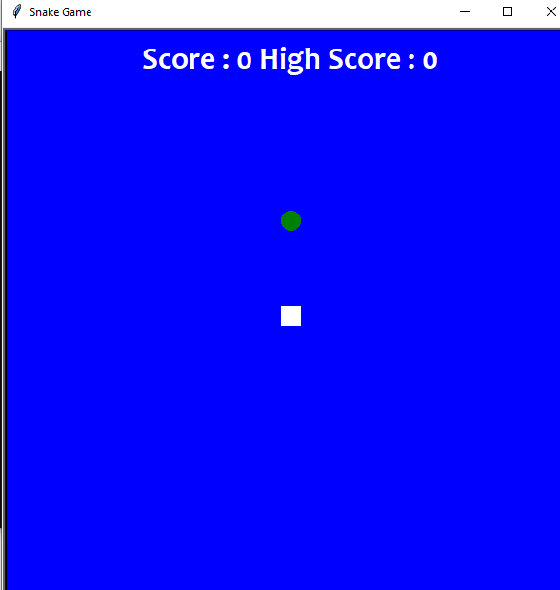
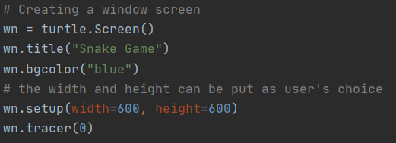
Step 2: Now , Create the display of the game

Slide 15
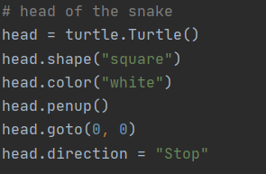
Step 3: Now , Creating Head of snake

Slide 16
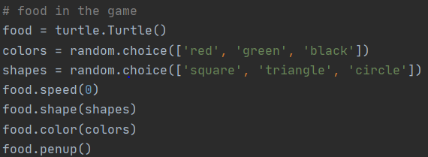
Step 4: Now , Creating Food Particle

Slide 17
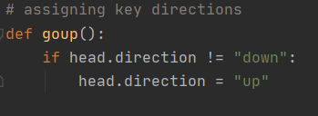



Step 5: Validating the key for the snake’s movements.

Slide 18
Step 6: Now, lastly, we will create the gameplay where the following will be happening
The snake will grow its body when the snake eats the fruits.
Giving color to the snake’s tail.
After the fruit is eaten, the score will be counted.
Checking for the snake’s head collisions with the body or the wall of the window screen.
Restarting the game automatically from the start after the collision.
The new shape and color of the fruit will be introduced every time the window is restarted.
The score will be returned to zero and a high score will be retained until the window is not closed.

Slide 19
First Phase Output

Slide 20
NEW UPDATE!!
Earlier we have designed the snake game by using basic turtle and random module. Now in this version we have introduced new modules and new user interface, which had completely changed the face of our game and to make it more user interactive we have added sound of churping the food🌝
The new modules are-:
Pygame
Sys (System-specific parameters and functions)
vector

Slide 21
What is Pygame?
Pygame is a cross-platform set of Python modules which is used to create video games.
It consists of computer graphics and sound libraries designed to be used with the Python programming language.
Pygame was officially written by Pete Shinners to replace PySDL.
Pygame is suitable to create client-side applications that can be potentially wrapped in a standalone executable.

Slide 22

Importing New Modules
Random: This function is used to generate random numbers in Python by using random module
Pygame: This is a cross-platform set of Python modules which is used to create video games.
Sys: System-specific parameters and functions. This module provides access to some variables used or maintained by the interpreter and to functions that interact strongly with the interpreter. It is always available.

Slide 23
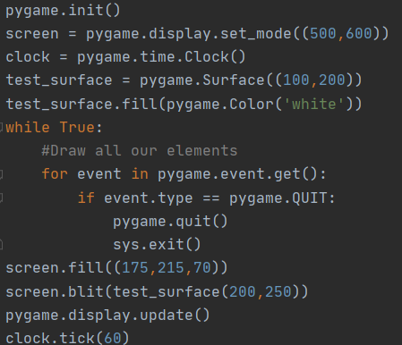
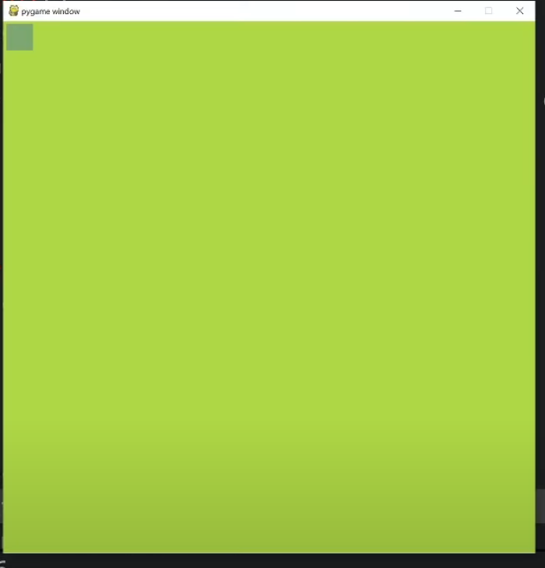
Creating main screen

Slide 24
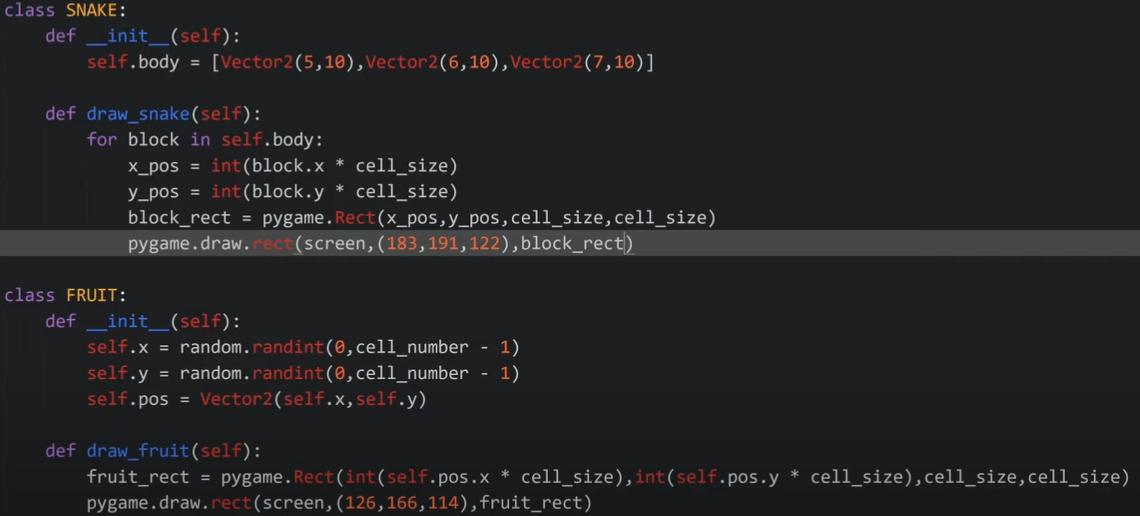
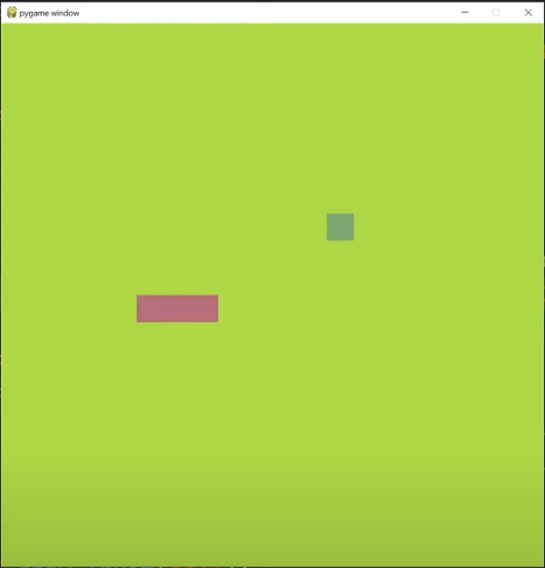
Creating the snake and fruit

Slide 25
Movement of Snake
Now, moving the snake
The head is moved to a new block and the block before the head gets the position where the head used to be and each block is moved to the position of the before that used to be before it (this deletes the last block)
Like: [ pos1, pos2, pos3 ] [ direction ]

Slide 26
Adding graphics in fruit and snake

Slide 27
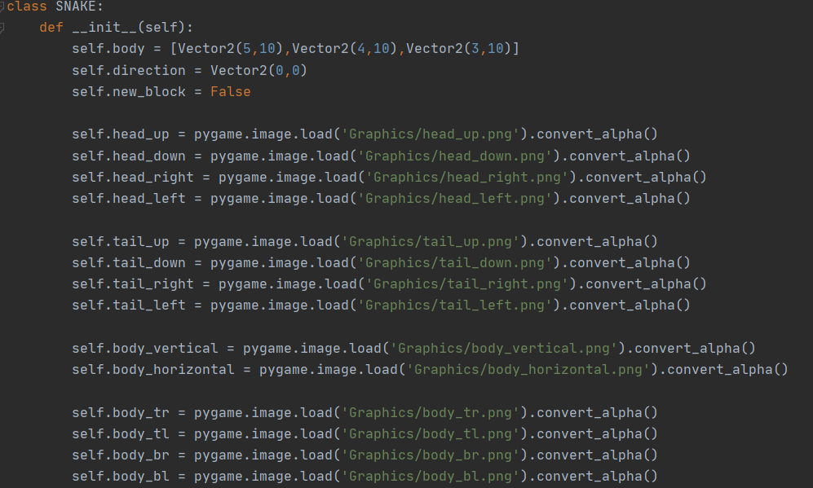
For snake

Slide 28
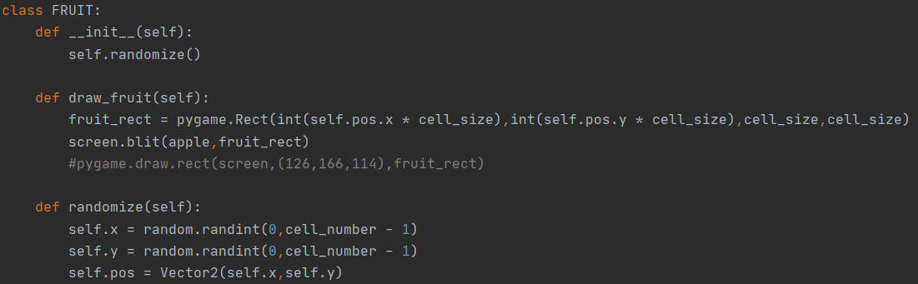
For Fruit

Slide 29
Output

Slide 30
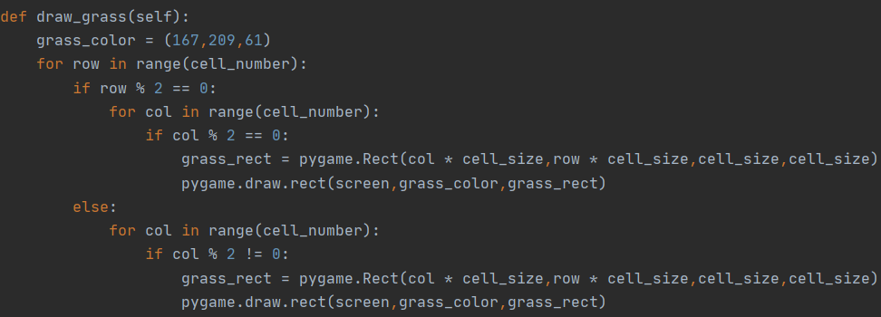
Now, Adding Grass in it

Slide 31
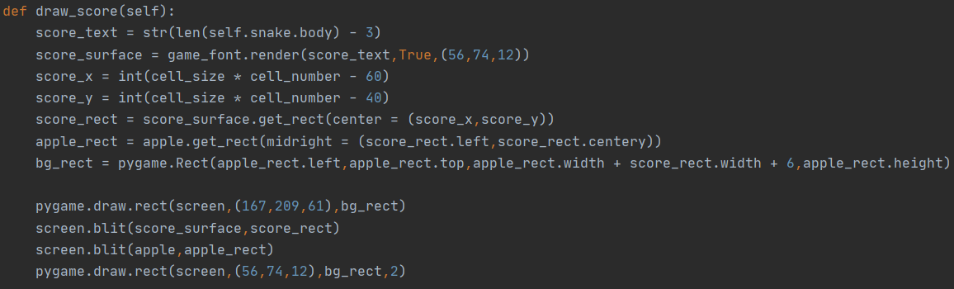
Now, Adding the scoreboard

Slide 32
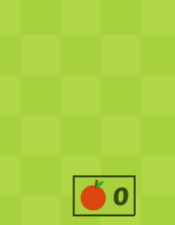
Scoreboard Output

Slide 33


Now, Adding the sound
Location of Sound File
Function of Sound

Slide 34
TADAA, Game is Ready!

Slide 35
PROJECT SCOPE
It will bring back the old classic game memories and will not harm children as much as games are harming these days such as PubG it is not a addictive game.
We can promote this game more and more using different OS platforms.
We can add some study tricks and quiz so kids can learn with game too.
It also increase the hand – eye coordination

Slide 36
REFRENCES
https://en.wikipedia.org/wiki
https://www.youtube.com
https://www.cs.bham.ac.uk
https://www.pygame.org/news
https://www.geeksforgeeks.org/introduction-to-pygame/
https://www.tutorialspoint.com/python/python_modules.htm#:~:text=A%20module%20is%20a%20Python,can%20also%20include%20runnable%20code.
https://www.lfd.uci.edu/~gohlke/pythonlibs/

Slide 37
